Slide 1
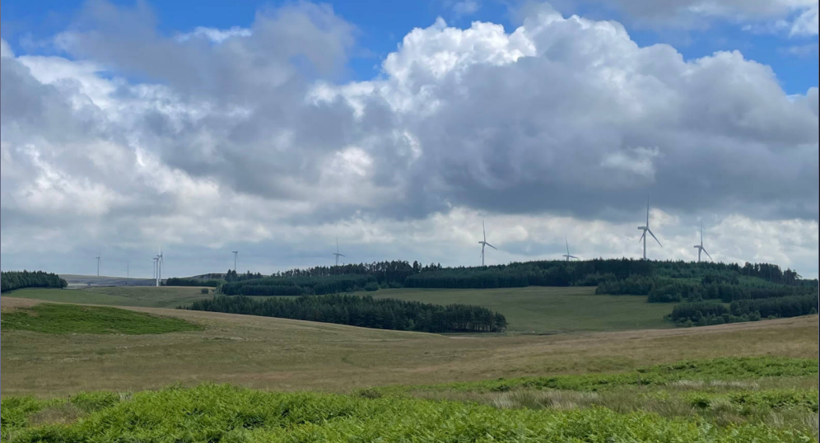
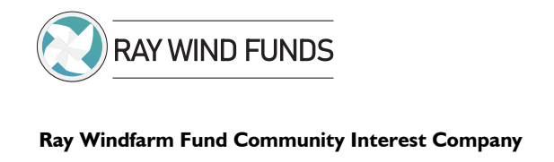
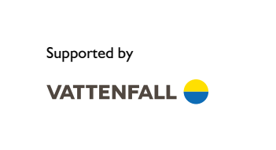
Annual Report 2024
Fund report – Year 6
This report covers the operation of the fund from 1 June 2023 through to 31 May 2024

Slide 2
The Chair
I am pleased to introduce this sixth annual report of the Ray Windfarm Fund CIC including details of grants awarded.
Donations from the Funds now total over £1.5m over the six years. This is an amazing milestone. During the past year applications for funds have been extremely diverse. Applications to the Community Benefit Fund included safety equipment for open water swimming, school extra mural activities, playing field equipment updates, sports centre management salary support and holiday clubs for children, performing arts, village hall upgrades and business developments. The major project being supported is ensuring full fibre broadband is made available to many properties in the area of benefit. Applicants are encouraged to seek match funding.
Eleven grants were made via the Education, Apprenticeship and training bursary scheme. By supporting businesses and training we seek to promote the local economy and ensure local job opportunities.
Over twenty grants were made from the Small Donations Fund, including set up costs for a new volunteer group, defibrillator maintenance, supporting a mental health event for local farmers and activities for isolated community members.
Community engagement remains a priority with local consultation and public events.
The Board is seeking new members who will bring a deeper insight into the needs of our community and continue to ensure the diversity of members. I would like to thank all Board members for their support and substantial contributions to the running of the company and decisions made. Thanks are due to Jo Willis for her tireless and professional work as our Community Development Officer and for performing administrative duties.
I am stepping down as Chair at the end of July and am pleased to advise that the role will be in the capable hands of Sarah Crone.
D.R.B. BURN

Slide 3
Executive Summary
The Ray Windfarm Fund, established in 2017 by Vattenfall. Ray Windfarm Limited, on behalf of Vattenfall has committed funds for the life of the Windfarm.
During the reporting year the sixth annual grant to the CIC was for the value of £375,750.
The different funds set up by the CIC are detailed within the report. A summary of grants awarded within the year is:
Community Benefit Fund (including grants agreed but not yet paid) £351,401
Small Donations Fund £11,592
Education Apprenticeship and Training Bursary (including grants agreed but not yet paid) £14,516
The CIC refers to the Community Action Northumberland (CAN) survey conducted in 2016, and the subsequent Community consultations carried out in 2022 to form priorities for grant allocations. Progress reports are made to Parish Councils, on the website (https://raywindfund.co.uk) and on Facebook (https://www.facebook.com/ray.windfunds).

Slide 4
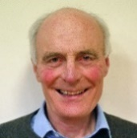
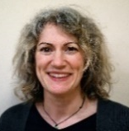
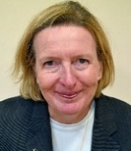
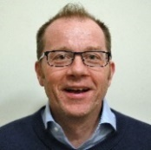
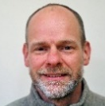
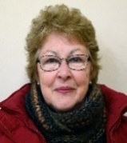
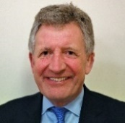
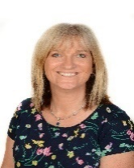
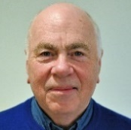
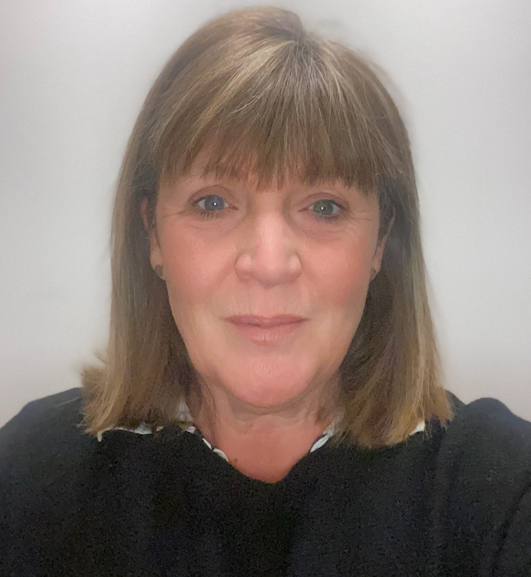
CIC Directors
David Burn - Chair
Birtley Parish Council
Member of the Finance and General Purposes Committee and Member of Application Review Committee
Katie Wood
Lay member
Member of the Finance and General Purposes Committee
Sarah Crone - Vice Chair
Lay member
Chair of Application Review Committee
Paul Cowie
Elsdon Parish Council
Martin Chilvers
Company Secretary
Otterburn Parish Council
Member of the Finance and General Purposes Committee
Lesley Gosling
Lay member
Member of Application Review Committee
Chris Robson – Treasurer
Lay member
Chair of the Finance and General Purposes Committee
Alison Thomson
Corsenside Parish representative
Member of the Finance and General Purposes Committee
Peter Ramsden
Bavington Parish Council
Member of Application Review Committee
Deb Walton
Lay member
Member of the Application Review Committee

Slide 5
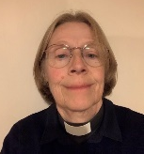
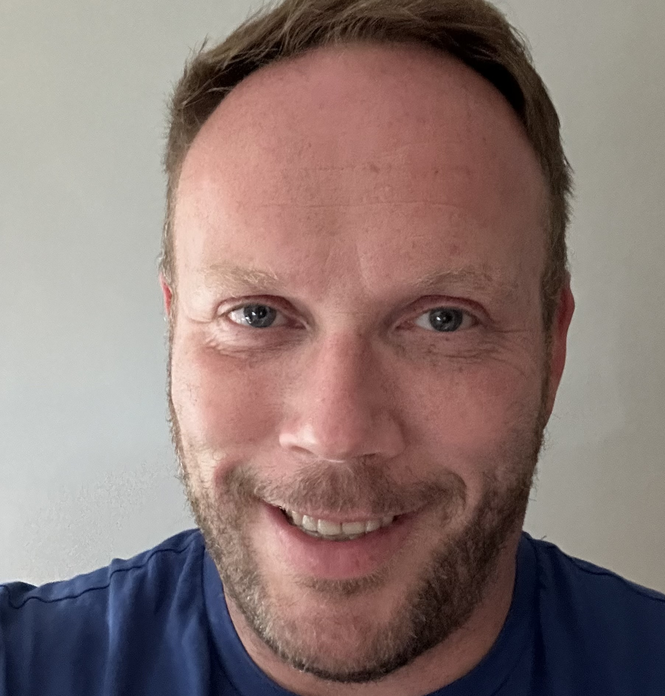
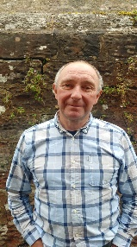
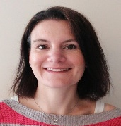
CIC Directors
Rev Sarah Lunn
Lay member
Member of the Application Review Committee
Meetings
Currently there are monthly meetings of the full CIC Board. The minutes of each meeting are signed by the Chair (or his representative) after approval at the following meeting and are then published on the website.
The Finance and General Purposes Committee hold bi-monthly meetings.
The Application Review Committee hold meetings monthly.
Martin Dickson-Green
Lay member
Member of the Application Review Committee
Phil Lawless
Kirkwhelpington Parish Council
Jo Willis
Community Development Officer

Slide 6
Income and Expenditure
Opening balance 1 June, 2023 |  |  |  | £7,045.91
Income
 | Vattenfall Wind Power Ltd |  |  | £375,750.00
 | Other (inc bank int. B4RN shares/invest, Ins claim) |  |  | £5,988.34
 |  |  |  | £381,738.34
Expenditure
 | Grants released in period |  |  | £270,020.00
 | Small Donations Fund |  |  | £11,592.34
 | EAT Bursary |  |  | £13,016.00
 | Schools |  |  | £47,610.00
 | Grants agreed but not yet released |  |  | £35,271.00 | *
 |  |  |  | £377,509.34
Fund Expenses
 | Administration costs |  |  | £21,327.02 | **
 | Fund expenses |  |  | £3,867.64 | **
 | Ongoing operational costs |  |  | £0.00
 |  |  |  | £25,194.66
Total available funds as at 31 May, 2024 |  |  |  | -£13,919.75
* ~ Grants included £5,000 RTC, £10,312 Adapt, £3,586 F & L Brewery Ltd, £6,825 S Cuthbert Joinery £1,655 All Stars Active CIC, £1,250 Chollerton First School, £4,873 Being Human Festival and £1,500 EAT Bursary,
** ~ Total of these two expenditures equates to 6.7% of the annual grant.
Applications in the year were strong and as a result there was a small deficit in the income and expenditure account which was met out of the provision for deferred income brought forward at the beginning of the year.

Slide 7

The Funds and Criteria
During the year there were four Funds:
The Community Benefit Fund (CBF)
This was formerly the Local Initiatives Fund.
The CIC was awarded £100,000 previously administered by the Community Foundation Tyne & Wear as the Small Grants Programme and it was decided to incorporate this fund and rename the reorganised Fund to ensure it was clear to all interested parties the aims of the Fund. The Fund is open to businesses and organisations which have the potential to deliver projects that benefit the communities within the area of benefit.
All applications are a two-stage process the first of which is to complete a preliminary enquiry form. Applicants will receive an acknowledgement within 10 days indicating the next date for consideration of completed full applications.
It is expected that the CIC Board will meet on up to six occasions a year to consider applications.

Slide 8
The Funds and Criteria
Small Donations Fund (SDF).
This Fund was launched in the 2020-21 grant year with an initial £10,000 put aside. The maximum grant that can be provided is £500. The application process of this fund is simplified and the applicant only needs to send an email providing a few key pieces of information. The assessment of the applications is an accelerated process via email between the CIC Directors.

Slide 9
The Funds and Criteria
The Education Apprenticeship & Training Bursary
This Fund was established last year as a response to feedback from the community consultation project carried out in 2022. The fund is available to individuals over the age of 16 wishing to develop or renew a career through further education, apprenticeships and training at all levels and to assist micro and small businesses to retain staff or create new employment opportunities.
The Legacy Fund
This fund is intended to continue providing community benefit beyond the operational life of the wind farm.

Slide 10
Grants Agreed
Community Benefit Fund – Grant Paid
All Stars Active CIC | £2,544 | Towards the cost of running children’s holiday clubs at RTC Otterburn
North Tyne & Redesdale Community Partnership | £7,500 | Towards the operating costs of weekly Soup & Sandwich Socials
Belsay Primary School | £4,185 | Musical instruments and equipment to deliver music lessons
H2O Trails | £14,000 | Towards safety equipment for the open water swimming venue
Wark Primary School | £4,980 | To fund extra-curricular activities and cost of living support for families and towards wraparound care and nursery
Belsay Primary School | £6,000 | To fund extra-curricular activities and cost of living support for families
Cambo First School | £6,000 | To fund extra-curricular activities and cost of living support for families
Chollerton First School | £4,560 | To fund extra-curricular activities and cost of living support for families
Otterburn Primary School | £7,380 | To fund extra-curricular activities and cost of living support for families and towards wraparound care and nursery
Bellingham Primary School | £4,080 | To fund extra-curricular activities and cost of living support for families
Bellingham Middle School | £1,360 | To fund extra-curricular activities and cost of living support for families

Slide 11
Grants Agreed
Community Benefit Fund – Grant Paid
Chollerton Preschool | £1,500 | Towards operating costs and cost of living support for families in nursery
North Tynies | £2,250 | Towards operating costs and cost of living support for families in nursery and wraparound
Cambo Wraparound | £2,250 | Towards operating costs and cost of living support for families in nursery and wraparound
Belsay Daycare | £2,250 | Towards operating costs and cost of living support for families in nursery and wraparound
Emma Anderson – Redesdale and Three Kirks Newsletter | £999 | Cost of new computer equipment to deliver weekly newsletter
Gunnerton Playing Field | £1,307 | Towards cost of a basket swing seat
Kevin Piggford Driving School | £7,500 | Towards the cost of a replacement vehicle for driving lessons
Friends of Hexham Priory School | £2,500 | Towards the cost of a specialist adapted minibus
Phoenix 60+ Social Club | £2,709 | Towards the cost of transport for bus trips throughout the year
Redefest | £2,000 | Towards the running costs of festival including replacing car park matting

Slide 12
Grants Agreed
Community Benefit Fund – Grant Paid
Bellingham Parish Council | £12,500 | Towards the cost of new play equipment and safety surfaces in the playground
Broadband for the Rural North B4RN | £100,000 | Towards the build costs of the Barrasford fibre broadband project
Corsenside Parish Hall | £20,000 | Towards the cost of the final refurbishments of the hall with insulation and cladding
RTC Sports | £5,000 | Towards the cost of the salary of the Centre and Development Manager
Neil Jones Property Development Ltd | £12,000 | Towards the cost of a second hand dumper truck
Capheaton PC | £1,500 | Towards the cost of a replacement wooden community notice board
Bellingham Golf Club | £2,000 | Towards the cost of a course of lessons to attract more children, young people and women members
North Tyne Youth | £25,000 | Salary of a youth worker
Kirkwhelpington PC | £1,100 | Replacement basket swing in park
Birtley Village Hall | £1,500 | Internal repairs to woodwork in supper room
Barrasford Village Hall | £8,500 | Towards repair and insulation f external walls of supper room and installation of heaters

Slide 13
Grants Agreed
Community Benefit Fund – Grant Paid
Semibreve CIC | £2,500 | Towards the cost of filming Howay the Lasses performing at Kirkwhelpington helping to form part of a larger Heritage Lottery Fund bid
Kirkharle Creative | £5,000 | Towards the cost of hosting a summer series of concerts at St Wilfred’s, Kirkharle
Otterburn Primary School | £1,000 | Towards the cost of Year 5 to 6 residential trip
Sarah Morpeth | £4,651 | Towards the cost of workshop refurbishment and start-up costs of craft workshops in Elsdon
Otterburn Memorial Hall | £5,000 | Towards the cost of roof and guttering repairs
Wark Primary School | £4,000 | Towards the cost of Year 3 to 6 residential trip
North Tyne & Redesdale Community Partnership | £18,525 | Towards the cost of replacing windows at Station House

Slide 14
Grants Agreed
Community Benefit Fund – Grant agreed but not yet paid
RTC Sports | £5,000 | Towards the cost of the salary of the Centre and Development Manager
Adapt | £10,312 | Running costs of Byrness to Morpeth bus for one year
F & L Brewery Ltd | £3,856 | Towards the groundworks, purchase and installation of a weatherproof gazebos to provide extra seating for the taproom
S Cuthbert Cabinet Making & Joinery | £6,825 | Towards the cost of a planer thicknesser to develop business and create employment
All Stars Active CIC | £1,655 | Towards the cost of running children’s holiday club at RTC Otterburn
Chollerton First School | £1,250 | Towards the costs of EV charging points to generate income
Being Human Festival | £4,873 | Towards the running costs of the festival at Bellingham Heritage Centre involving local schools and youth groups
Total | £351,401

Slide 15
Grants Agreed
Small Donations Fund – Grant Paid
Wilder Wallington | £500 | Towards the start-up costs of a volunteer group at Wallington Hall
Elsdon Projects in the Community (EPIC) | £345.99 | Towards cost of sundry items for marquees
Rochester PC | £500 | Towards the cost of a replacement defibrillator
Kirkwhelpington Show | £500 | Towards running costs of the village show
Wark Juniors FC | £500 | Trophy Day
Byrness Village Hall | £500 | Towards the cost of internal decoration of the hall
Friends of Corsenside | £312.75 | Towards the relocation of Northumberland Dark Bees
RTC Otterburn | £490 | Towards costs of 35th anniversary celebration and relaunch
Chatty Café Bellingham | £432.90 | Towards the running costs of Chatty Cafe
Wark Town Hall | £500 | Towards the heating costs of Hall, a designated Warm Hub
Capheaton PC | £338.99 | Defibrillator battery and pads
Corsenside PC | £500 | Towards the cost of replacement defibrillator case
North Tyne & Redesdale Community Partnership | £221.64 | Hangers and clothing rails for the local pre-loved clothing sales

Slide 16
Grants Agreed
Small Donations Fund – Grant Paid
Elsdon Village Fireworks | £500 | Towards the cost of operating the village firework display
Otterburn PC | £500 | Towards cost of a solar light
Kirkwhelpington PC | £500 | Towards the cost of a replacement defibrillator case
Church & Community Partnership Tynedale | £403.40 | Set up costs for launch of mental health event at Hexham Mart for local farmers
Chollerton PCC | £500 | Towards cost of dry stone wall repair at St Giles, Chollerton
Otterburn Flood Group | £136.74 | H & S equipment for Flood Group volunteers
Bird in Bush | £500 | Towards the cost of bicycle repair pump and bicycle stands for new cycling café venture
Elsdon Village Hall | £477.90 | Equipment costs to operate the Warm Hub at Elsdon VH
Chollerton Pre-school | £500 | Towards the cost of pre-school summer trip to Northumberland Zoo
Culture in a Cool Place | £470 | Projector and equipment for events at St Cuthberts, Elsdon
Time Bandits | £500 | Costs of making a film of reiver activity at Evistones working with local schools
Chatty Café Bellingham | £462.03 | Towards the running costs of the Chatty Cafe
Northumbrian Mounted Archers | £500 | Towards the cost of a taster day for mounted and walking archery
Total | £11,592.34

Slide 17
Grants Agreed
Grants awarded from Education Apprenticeship and Training Bursary (EAT Bursary ) - Grant Paid
Individual Ridsdale | £1,000 | Performing Arts Course, Liverpool 2nd year
Individual Chollerton | £1,500 | Agricultural College, York
Individual Bellingham | £1,500 | Games Design, Teeside
Individual Ridsdale | £1,500 | Performing Arts Course, Liverpool
Individual Birtley | £1,000 | Agricultural College, York 2nd year
North Tyne Youth | £1,016 | Level 3 Youth Training for new staff member
Individual Wallington | £1,500 | Agriculture and Farm Business Management, Newcastle University
Individual Birtley | £1,000 | Agriculture apprenticeship, Myerscough College Hexham Mart
Individual Otterburn | £1,500 | Agriculture, Newcastle University
Individual Elsdon | £1,500 | Performing Arts Course, Hertfordshire
Grant agreed but not yet paid
Individual Otterburn | £1,500 | Livestock Production Course, East Yorkshire
Total | £14,516

Slide 18
Grants Agreed
The total Grants split by applications from Parishes within the catchment area and against the broad priorities highlighted from the CAN survey are shown in the two charts below.

Slide 19
Grants Agreed

Slide 20
Fund Achievements
The £100,000 formerly transferred to the Community Foundation Tyne & Wear to administer the Small Grants Programme remained in house and was incorporated in the Community Benefit Fund, Directors have ensured the money was ringfenced for charitable and community organisations as was the case with the Small Grants Programme.
The Ray Wind Funds have continued to support Primary and First Schools within the area of benefit. It was noted many families continued to experience financial pressures due to the cost-of-living crisis. It was agreed to renew the support for preschools, nurseries and wraparound childcare facilities, and the former amount of £30,000 awarded in previous years was increased to approximately £50,000, split between the three school terms. Bellingham Middle School was included in this increased funding for the final term and will continue to be awarded termly funding. Schools have used the grant funding to subsidise the increased transport costs for swimming lessons and school trips. Some have carefully assisted disadvantaged families covering the cost of school meals, breakfast and/ or after school childcare costs. Otterburn and Wark Primary Schools were also awarded funding to enable the Key Stage 2 children to take part in the residential trips for outdoor activities building resilience and confidence and learning new skills.
Surveys of the local community have consistently identified provision of Broadband as a top priority for our Fund. A grant to Broadband for the Rural North (B4RN), a Community Benefit Society, was the largest awarded to date at £100,000. This is in support of many years of tireless work by volunteers for Broadband for North Tyne and Redesdale (B4NTR). Directors were fully aware many in our catchment community have felt left behind in the IT infrastructure department.
The first stage of the build, the Barrasford project, was to bring full fibre Gigabit broadband to every property in the parishes of Chollerton and Birtley. B4RN were initially successful in securing government funding through Project Gigabit with the remainder coming from individual community investment and substantial support from our Community Benefit Fund. Community buildings and schools are connected free of charge and households are offered competitively priced packages for both broadband and phone connection. The project build and home connections were commenced in autumn 2023 to much celebration among the local community. Directors are proud of the part the Ray Wind Funds have played in ensuring the delivery of broadband to potentially up to 600 properties which will greatly improve the quality of life for people in Chollerton and Birtley. We all know post pandemic how access to broadband and streaming services became an essential part of everyday life whether home learning, working from home, running a business, doctors appointments, keeping in touch with family and friends via Zoom, Teams or Facetime and streaming boxsets and films. The government funding accessed for this project totalled £812,000.

Slide 21
Fund Achievements
The local economy has also been supported with six businesses within the area of benefit receiving nearly £50,000. This has included investment in capital items to ensure that the services provided offer the best value for those living within the area of benefit with the hope in some cases of increasing employment (S Cuthbert Cabinet Making & Joinery, Neil Jones Property Development Ltd, First and Last Brewery and Kevin Piggford Driving School). Sarah Morpeth requested funding to replace her workshop floor and employ a part time employee to assist with the administrative side to her craft business. She was eager to commence her craft workshops in Elsdon, and the grant has enabled her to hire a local tradesperson to undertake the work and workshops will start shortly attracting participants from across the county and from over the border in Scotland, with benefit for local accommodation and hospitality businesses. H2o Trails required replacement equipment in order ensure their open water swimming venue maintained their health and safety requirements allowing local schools and youth groups to learn about the safe way to enjoy open water swimming along with members of H2o Trails.
Community facilities such as playing fields and four village halls have received funding this year. In some cases, this has completed refurbishment projects ensuring buildings are heated in an efficient, sustainable manner and that those hiring facilities will benefit from a warmer more pleasant space. Many of these village hall facilities are now classified as ‘Warm Hubs’ and will act as a meeting place in times of emergency due to storms and power cuts. We have funded replacement play equipment in three villages, matching support from other funders or parish council funds.
Grants to local voluntary organisations included the Phoenix 60+ Social Club, who run monthly bus trips to places across the North of England and Scotland. This supplemented the Group’s own fundraising events enabling a top up for the rising cost of transport to ensure their calendar of events could continue. A grant was given to the North Tyne and Redesdale Community Partnership who run a Soup & Sandwich Social every Monday attracting people from Bellingham and outside the village and allowing a regular meeting place for those experiencing isolation and loneliness. Bellingham also received funding for the Chatty Café, open on a Tuesday at Fountains Cottage Café, where tables are branded with the national Chatty Café logo for people to catch up and socialise. The organisers have successfully arranged for guests to help those experiencing bereavement with issues about dementia and the café staff have undergone dementia friendly training.

Slide 22
Fund Achievements
The Education Apprenticeship and Training Bursary received more applicants this year, with eleven grants awarded, ten of those were to individuals and one to North Tyne Youth who wished a new member of staff to receive training. We would like to remind everyone, that anyone over the age of 16 can apply to continue their further education, undertake training or an apprenticeship. It is also open to older individuals wishing to make a career change or gain extra qualifications to improve their employability. Small and medium businesses are also entitled to apply if they have staff who require training or are wishing to take on an apprentice.
The Small Donations Fund remains popular with the shortened application process, quick decisions and transfer of grants making it easy for people requiring a small amount of funding to help with a project such as defibrillator battery replacement, equipment for Warm Hubs, sports group start-ups or trips for nursery children.
The match funding facilitated by successful grant applicants to the Ray Wind Funds over the year has exceeded £1,110,000, in part due to the large investment by the government in Project Gigabit for Broadband rollout, but other grant giving trusts and organisations have also played their part. This figure does not take into consideration the funds put forward by applicants from their own reserves, bank accounts or profits to progress projects.

Slide 23
Next 12 Month Plans
Directors decided that it was important to for the strategic development of the B4RN broadband project that funding was granted for the second phase of the rollout across Bavington, Kirkwhelpington and Wallington and the third and final phase to Corsenside. The funding for this project has been committed for the next three grant years commencing next year, the 24-25 grant year.
North Tyne Youth also received a grant for three years towards the salary of a youth worker who will run sessions across our area of benefit. This three-year grant commenced this year, 2023-24 and will be awarded for a further two years. This multi-year grant will allow the organisation to plan knowing that some of their core costs are covered with opportunity to seek further match funding elsewhere.
Directors wish to continue their support for schools, pre-schools, nurseries and wraparound care within the area for extracurricular activities transport costs and with continued help for disadvantaged families experiencing financial pressures.
In the light of these commitments Directors have decided to amend the suggested maximum grant award within the Community Benefit Fund from £20,000 to £10,000. Projects that offer significant community benefit but require higher level of funding would still be eligible although this would be considered exceptional. Grant decisions and meetings of the Board will now be scheduled for alternate months – January, March, May, July, September and November.
Transport remains a priority identified by the community and the Adapt weekly dial-a-service from Byrness through to Morpeth which began in July 2021, with good passenger numbers and feedback, will be repeated in the 2024-25 grant year. There is an acute need for volunteer drivers and for transport for those individuals wishing to attend social groups and healthcare appointments. We will continue to work with the collective group of organisations wishing to tackle issues surrounding community transport.
Further support will be offered alongside other funders to ensure local resilience to inclement weather in the wake of Storm Arwen.
Work with local show committees has commenced to award a Show Core Fund with distribution to Bellingham, Corsenside, Elsdon, Kirkwhelpington and Rochester. The local shows are valuable events in the community calendar, allowing people to come together both on the day and year-round for fundraising events and planning for the show days.
We aim to continue with local businesses to improve employment opportunities, with particular emphasis on the Education Apprenticeship and Training Bursary. There will be continued cooperation with the Church and Community Partnership Tynedale to promote dementia friendly community facilities and businesses.

Slide 24
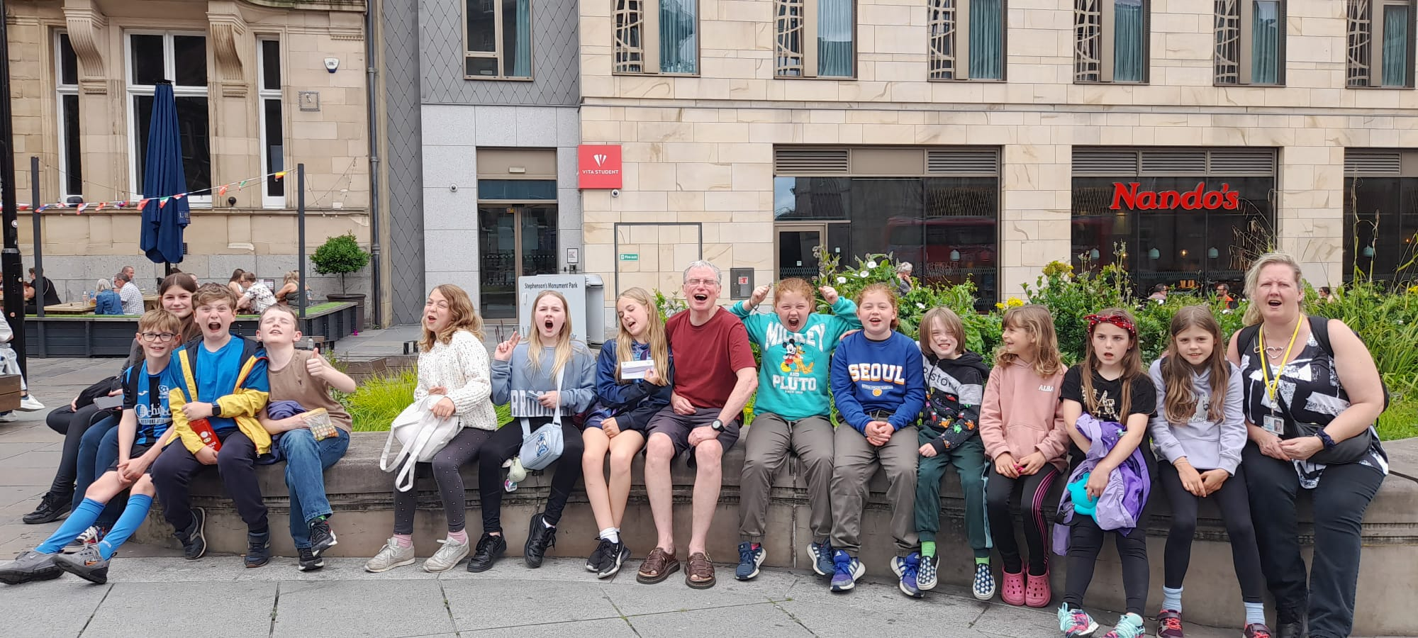
Case Studies
North Tyne Youth run youth clubs at Otterburn RTC, Bellingham, Kirkwhelpington and Humshaugh together with lunch clubs at Bellingham Middle School, Haydon Bridge High School, and Queen Elizabeth High School. They applied for funding to help to cover the cost of a salary for a youth worker for three years to run sessions at Otterburn, Kirkwhelpington, QE High School and Haydon Bridge High School. The children and young people experience a broad range of activities within the youth club sessions with additional trips and outings in holidays. Awarding this grant gave the group the confidence to forward plan offering stability to the children and young people to build trust with their youth workers. Match funding of £65,000 was secured from The Big Lottery and Ballinger Trust to guarantee the immediate future of the organisation.
Rural isolation presents a challenge for our young people and this was significantly exacerbated by the Covid pandemic. NTY believe our young people deserve access to tailored support in the form of high-quality youth work services that take place at a time and place convenient for them
The youth sessions are extremely varied covering crafts (for example making badges, Chinese New Year decorations and sherbet), drumming workshops, board games and sports together with talks from professionals about the dangers of drugs, vaping and smoking. The seniors are encouraged to act as mentors for the junior youth club groups enabling the children to develop their leadership skills.
"Ray Wind Fund's generous funding enables North Tyne Youth to work with young people aged 8-18 in the Fund's area of benefit. With this year's grant, we've been able to step in and support a local village youth club to prevent it from closing (and to keep offering a weekly club for more than 25 young people!), take young people on outdoor swimming sessions that have taught open water safety and developed confidence and competence, and start a youth cafe that runs year-round in term-time, supporting young people aged 11+ to build independence skills and facilitating social relationship-building. Knowing that we have RWF's funding for three years allows us to offer stable youth provision that grows with our young people, so that we can meet their needs and work to develop responsive new projects too." Lisa Robinson, Youth Development Worker
NTY Theatre trip
Community Benefit Fund
North Tyne Youth
£25,000 per year for three years

Slide 25
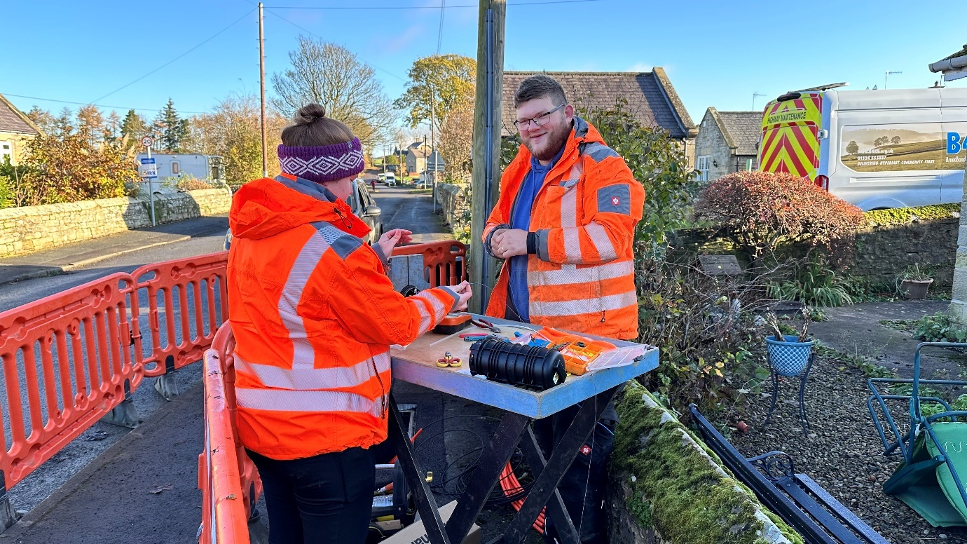
Case Studies
From the inception of the Ray Windfarm Fund Community Interest Company in August 2017 and following a community survey conducted by Community Action Northumberland (CAN) discussions about provision of broadband to our isolated community have been taking place. The need for superfast broadband was a key priority of this survey and in the following years the RWF has collaborated with Broadband for North Tyne and Redesdale (B4NTR), a volunteer group to ensure it was delivered to the area. Lynne Rawles, of B4NTR and B4RN’s Volunteer Champion for Barrasford, Kirkwhelpington and Woodburn said. “Our story started with a need for better broadband in a poorly served remote area of Northumberland. I initially brought together fifteen volunteers from eight rural parishes with a dream to offer every property who wanted a 1,000 megabits fibre broadband connection to their door. We researched and approached several suppliers before finding B4RN. Out of all the suppliers B4RN was the only one to commit to supplying every property in each parish no matter how distant and remote. No-one would be left behind.”
Conversations with Broadband for the Rural North (B4RN) began and Directors of RWF and local volunteers of B4NTR who have worked tirelessly over the years are very happy that the hard work and perseverance has paid off. We received an application for the first phase of the project, the Barrasford build in September 2023 and along with government funds through Project Gigabit and local investors individually contributing £979,000, we awarded the largest RWF grant to date of £100,000.
"We are delighted that our Barrasford project is nearing completion and would like to extend our sincere appreciation to Ray Wind Fund for their support. This essential funding has been instrumental in enabling B4RN to deliver full-fibre gigabit broadband to rural communities." Tom Rigg, CEO of B4RN.
Community Benefit Fund
Broadband for the Rural North (B4RN)
£100,000 - Barrasford project

Slide 26
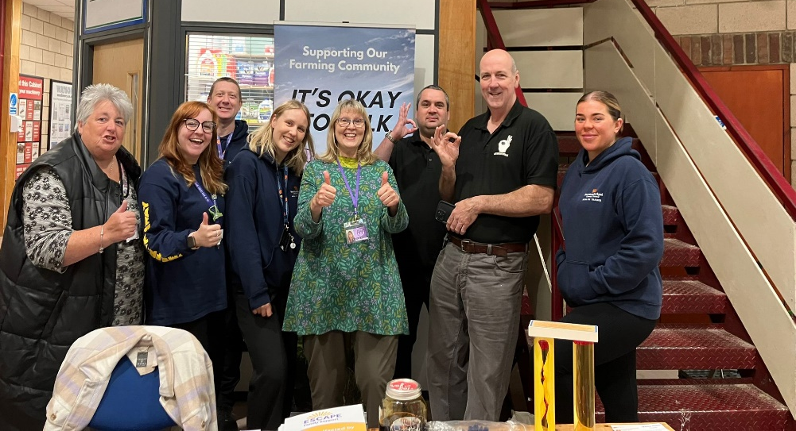
Case Studies
A working partnership was established by the Church & Community Partnership Tynedale with the Ray Wind Funds, Northumberland Young Farmers, Public Health and Community Services for Northumberland County Council and professionals from suicide prevention and mental health awareness organisations.
Many people in the farming community work alone under high pressure, stressful, physically demanding conditions and have been under increasing financial strain due to the imminent end to the Basic Payment subsidy following Brexit. The profession and associated industries have a very high rate of suicide with 88% of farmers under 40 ranking poor mental health as the biggest hidden problem facing the industry.
The group had wanted to establish links with Hexham Mart to replicate a successful monthly session already taking place at Wooler Mart, where farmers can receive physical health checks such as blood pressure checks, general healthy living advice and the ability to have a 30-minute full health check from NCC public health. Alongside this, mental health workers would be in attendance with leaflets listing support available. Our Community Development Officer, Jo Willis, who helps her partner on their beef and sheep farm had links with Hexham Mart and helped to establish a conversation about the monthly sessions. The Church & Community Partnership applied for a grant to cover the cost of refreshments for the first session at the mart and to print 1000 mental health helpline cards.
All café staff, hairdressers and some mart droving staff have undergone mental health awareness and suicide prevention training because of the monthly mart sessions. Farmers have undertaken quick health checks, and many have also undergone the longer physical health checks, resulting in serious symptoms requiring hospitalisation. Continuing the monthly presence at the mart has helped farmers feel comfortable with the MH professionals in attendance and has allowed some to request help and start difficult conversations about their mental health needs.
Photo showing Church & Community Partnership’s Caroline Clarke with representatives of Andy’s Man Club, Papyrus Young suicide, Public Health Trainers and Escape
Church & Community Partnership Tynedale –
mental and physical health checks in the farming community
£403.40
Small Donations Fund

Slide 27
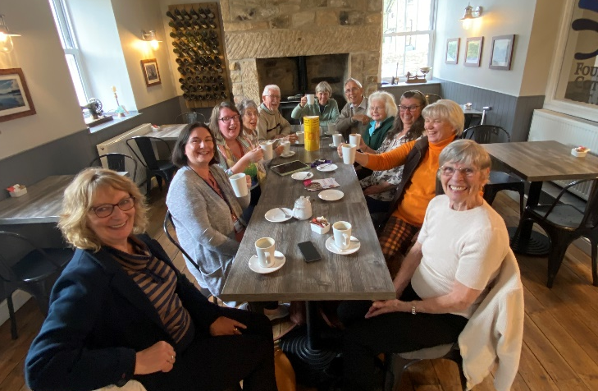
Case Studies
The local group organising the new weekly Chatty Café in Bellingham applied for funding for their running costs. The Chatty Café is a National Scheme aimed at tackling loneliness. The group wanted to focus on the more remote individuals that for one reason or another may be more “hidden” within the community. They also wanted to attract those who may have early-stage dementia and/ or their carers or those who are vulnerable or lonely in our community.
The grants awarded enabled the group to print leaflets to publicise the coffee mornings around the local community. The Chatty Cafe would be hosted at Fountains Cottage Café, Bellingham with specific tables liveried with Chatty Café branding. The grant would help to subsidise the cost of refreshments at the weekly sessions for attendees and their carers.
The group have established a regular core group of visitors to the Chatty Cafe and slowly numbers continue to grow. The gradual growth allows the Chatty Café volunteers to really get to know the person and ensure they are comfortable and become established in the café community.
The Chatty Café has been recognised as a positive influence within the health care team and have regular visits from the bereavement support at Tynedale Hospice and both the Dementia Advisor and the social prescribers for the local region.
The second grant awarded towards the end of the year ensured the continuation of the Chatty Café and that all attendees received refreshments when visiting the café.
The group have been advised to apply to the Community Benefit Fund for any future strategic funding along with approaching other funders and raising funds within the community.
“It is lovely to see the project taking off – and the funding has definitely helped us to grow, we now welcome between 12 to 22 people on a weekly basis.” Jane Morton, Chatty Café organiser.
Chatty Café, Bellingham – running costs for the
weekly sessions
£432.90 and £462.03
Small Donations Fund

