Slide 1
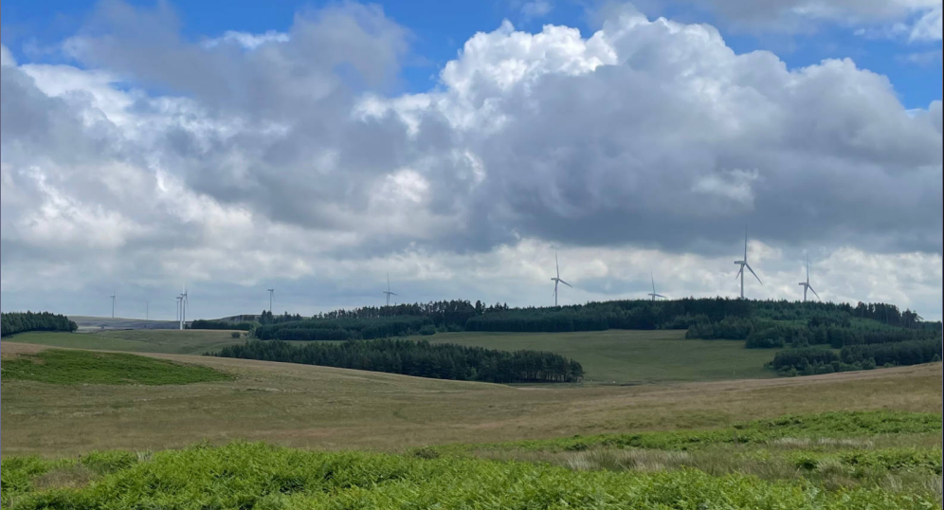

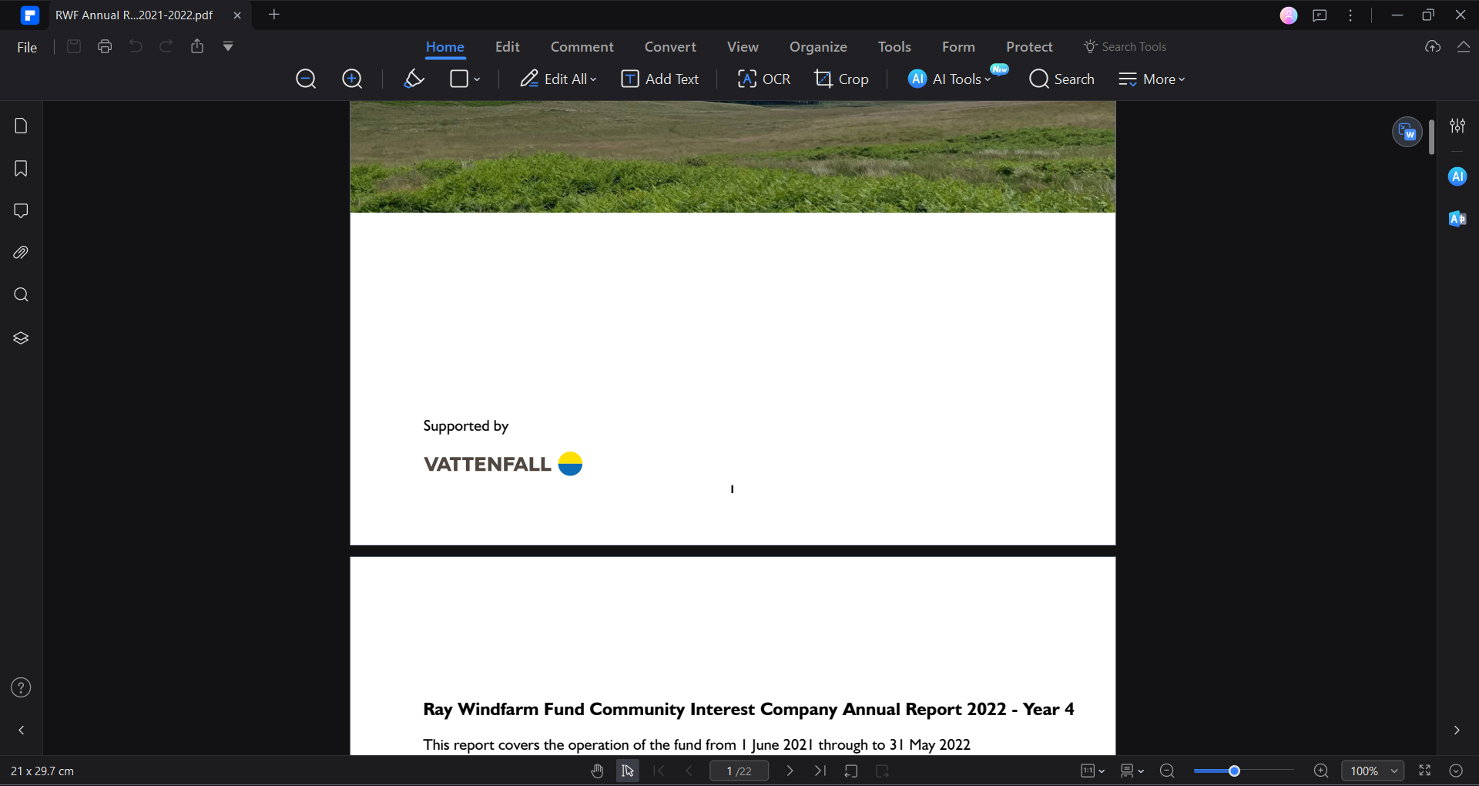
Annual Report 2025
Ray Windfarm Fund Community Interest Company
Fund report – Year 7
This report covers the operation of the fund from 1 June 2024 through to 30 June 2025

Slide 2
The Chair
It gives me great pleasure to introduce the Ray Wind Fund’s Annual Report for 2024–2025. This past year has been one of both reflection and progress, as we continue to build on our commitment to strengthening communities across our region.
Since the establishment of the Ray Wind Funds, our purpose has remained clear: to ensure that the benefits of Vattenfall’s Ray Windfarm are shared meaningfully with the communities that live around it. Over the last year, we have supported a wide range of projects that enhance local resilience, create opportunities for young people, strengthen local infrastructure and facilities, and support our local education settings.
What has stood out most this year is the spirit of collaboration. Community groups, local organisations, and volunteers have continued to come together with creativity and determination, ensuring that even modest grants are stretched to deliver lasting value, with several securing match funding from external funders. We have been proud to support initiatives that not only meet immediate needs but also invest in the future vitality of our rural communities.
The challenges facing our communities remain real—whether in terms of economic pressures, rural connectivity, or the impact of climate change—but the response has been equally real: practical, imaginative, and rooted in local knowledge. The Ray Wind Fund is only as strong as the people it serves, and this year has once again demonstrated the resilience, resourcefulness, and generosity that characterise our region.
I want to take this opportunity to thank my fellow Directors, Jo Willis, and all those who have contributed time, ideas, and energy to the Ray Wind Fund’s work over the past year. I would like to express particular thanks to David Burn who held the Chair’s position for four years previously and has remained as Vice Chair. Most of all, I extend my thanks to the local groups and individuals whose projects bring our aims to life.
As we look ahead, our focus remains firmly on ensuring that the Ray Wind Funds continues to be a trusted partner for local communities—responsive, forward-looking, and committed to maximising the long-term benefit of the Ray Windfarm for years to come.
Sarah Crone

Slide 3
Executive Summary
The Ray Windfarm Fund was established in 2017 by Ray Windfarm Limited, on behalf of Vattenfall, who have committed funds for the life of the windfarm. During this, the seventh reporting year, the annual grant to the CIC was £386,870.00.
The different funds set up by the CIC are detailed within the report. A summary of grants awarded within the year was:
Community Benefit Fund £320,115
Small Donations Fund £10,164
Education Apprenticeship and Training Bursary £10,634
The CIC refers to the Community Action Northumberland (CAN) Survey conducted in 2016 and the subsequent Community Review in 2022 to form priorities for grant allocations. Progress reports are made to Parish Councils, on the website (https://raywindfund.co.uk) and on Facebook (https://www.facebook.com/ray.windfunds).

Slide 4
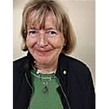
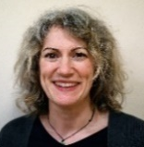
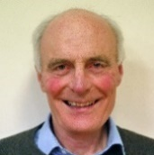
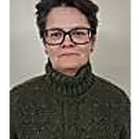
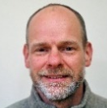
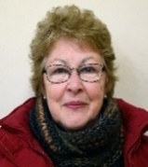
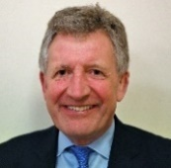
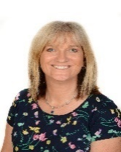
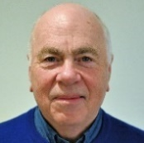
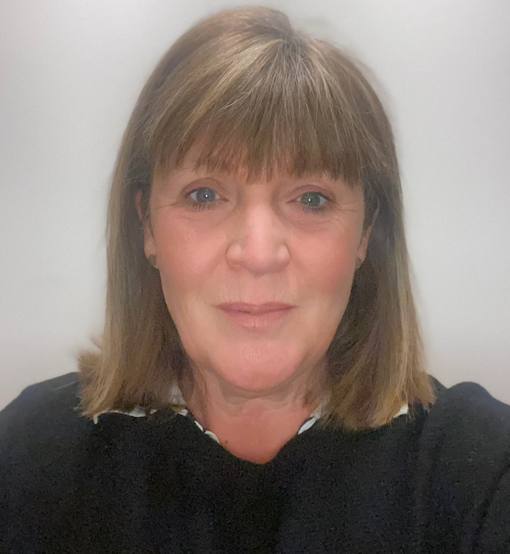
CIC Directors
Sarah Crone - Chair
Lay member
Member of the Finance and General Purposes Committee and Member of Application Review Committee
Katie Wood
Lay member
Member of the Finance and General Purposes Committee
David Burn - Vice Chair
Birtley Parish Council
Member of the Finance and General Purposes Committee and Member of Application Review Committee
Shirley Stuchfield
Elsdon Parish Representative
Martin Chilvers
Company Secretary
Otterburn Parish Council
Member of the Finance and General Purposes Committee
Lesley Gosling
Lay member
Member of Application Review Committee
Chris Robson – Treasurer
Lay member
Chair of the Finance and General Purposes Committee
Alison Thomson
Corsenside Parish Representative
Member of the Finance and General Purposes Committee
Peter Ramsden
Bavington Parish Council
Member of Application Review Committee
Deb Walton
Lay member
Chair of the Application Review Committee

Slide 5
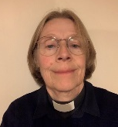
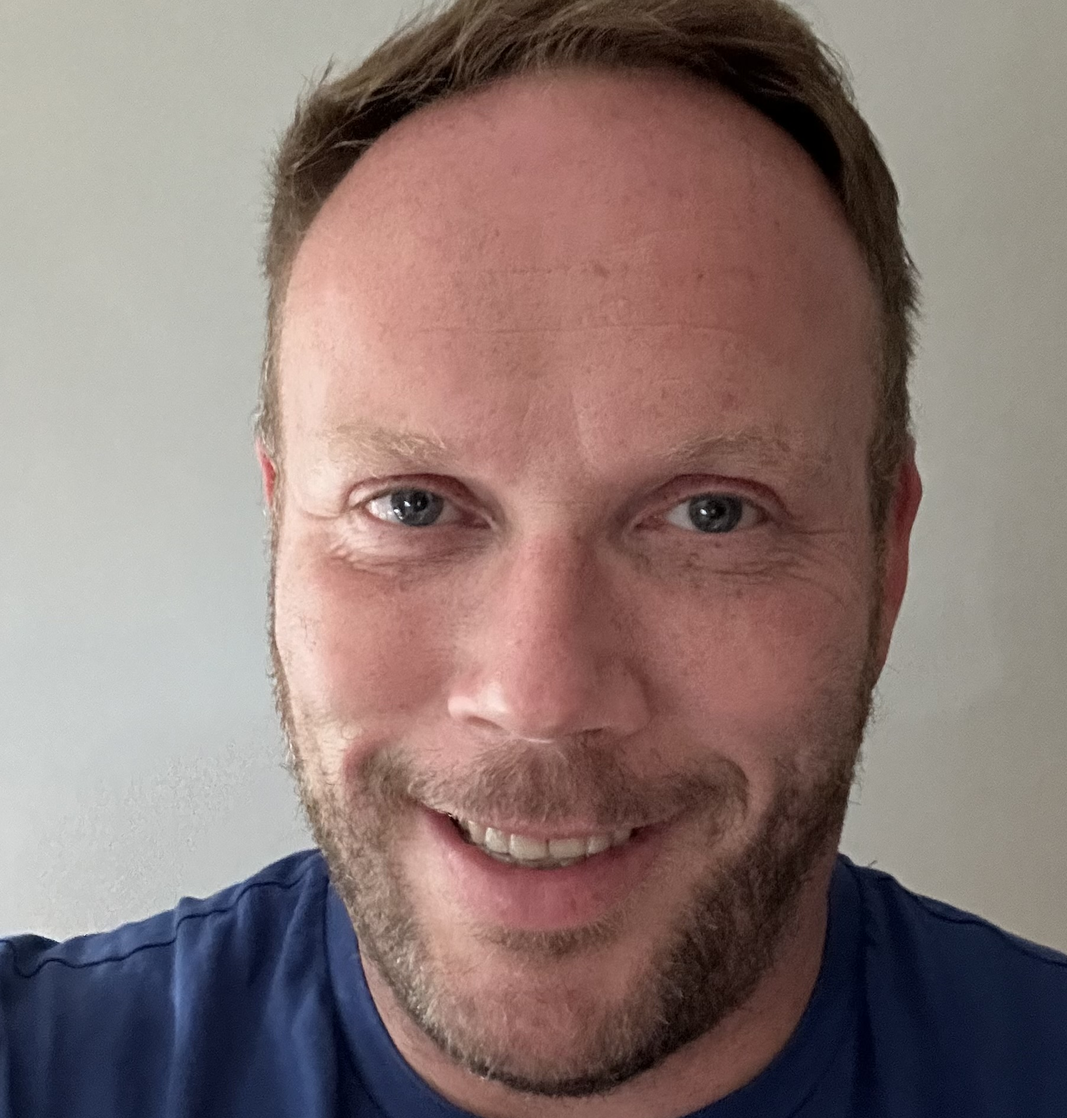
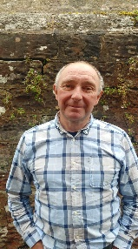
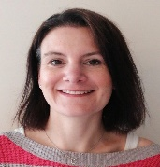
CIC Directors
Rev Sarah Lunn
Lay member
Member of the Application Review Committee
Meetings
Meetings of the Finance & General Purpose Committee take place on alternate months coinciding with meetings of the full CIC Board. The minutes of each meeting are signed by the Chair (or her representative) after approval at the following meeting and are then published on the website.
The Application Review Committee hold meetings monthly.
Martin Dickson-Green
Lay member
Member of the Application Review Committee
Phil Lawless
Kirkwhelpington Parish Council
Jo Willis
Community Development Officer

Slide 6
Income and Expenditure
Opening balance 1 June, 2024 |  |  |  | -£13,649.75
Income
 | Vattenfall Wind Power Ltd |  |  | £386,870.00
 | Other (inc bank interest & grants repaid) |  |  | £4,698.53
 |  |  |  | £391,568.53
Expenditure
 | Grants released in period |  |  | £262,788.00
 | Small Donations Fund |  |  | £9,664.00
 | EAT Bursary |  |  | £10,634.00
 | Schools |  |  | £45,250.00
 | Grants agreed but not yet released |  |  | £12,587.00 | *
 |  |  |  | £340,913.00
Fund Expenses
 | Administration costs |  |  | £20,095.77 | **
 | Fund expenses |  |  | £7,355.35 | **
 | Ongoing operational costs |  |  | £6,707.50
 |  |  |  | £34,158.62
Total available funds as at 30 June, 2025 |  |  |  | £2,847.16
* ~ Grants included CBF £4,300 Kirkharle Parkrun, CBF £7,787 Cambo First School, SDF £500 Wark Primary School
** ~ Total of these two expenditures equates to 7.1% of the annual grant. *** ~ Financial year end amended to 30 June to align with Grant Year

Slide 7

The Funds and Criteria
During the year there were four Funds:
1) The Community Benefit Fund (CBF) Formerly the Local Initiatives Fund this was renamed after the cessation of the transfer of £100,000 to the Community Foundation Tyne & Wear, who previously administered a Small Grants Programme on behalf of the CIC. The fund is open to Businesses and Organisations who have the potential to deliver projects with clear benefit to our local Community.
The first stage of the application process is to complete a preliminary enquiry form directly or through the online platform. After review by the Application Review Committee applicants receive an acknowledgement within 10 days. Assuming there are no outstanding queries, applicants will then complete a full application before assessment by the full CIC Board at their next meeting.
It is expected that the CIC Board will meet on up to six occasions within the year to consider applications.

Slide 8
The Funds and Criteria
2) Small Donations Fund (SDF).
This fund, launched in the 2020-21 grant year has been raised to £12,500 to reflect the interest and enquiries received. The maximum grant that can be provided is £500. The application process of this fund is simplified and an applicant is required to send an email providing a few key pieces of information or by application through the online platform. The assessment of the applications is an accelerated process via email between the CIC Directors.

Slide 9
The Funds and Criteria
3) The Education Apprenticeship and Training Bursary This fund was established in response to feedback from the previous Community Consultation. The fund is available to individuals over the age of 16 wishing to improve their prospects for employment or develop a new career through further education, apprenticeships and training.
4)The Legacy Fund
This fund is intended to continue providing community benefit beyond the operational life of the wind farm.

Slide 10
Grants Agreed
Community Benefit Fund – Grant Paid
Elsdon Projects in the Community (EPIC) Elsdon Show | £1,750 | Towards the operating cost of show
Corsenside Show | £1,750 | Towards the operating cost of show
Kirkwhelpington Show | £1,250 | Towards the operating cost of show
Wark Town Hall | £5,000 | Towards the cost of kitchen refurbishment and repair of building
Bellingham Show | £3,500 | Towards the operating cost of show
North Tyne & Redesdale Community Partnership | £1,242 | Towards the operating costs of Chatty Café, Bellingham
Upper Redesdale Show | £1,750 | Towards the operating cost of show
Bellingham Middle School | £4,500 | To fund extra-curricular activities and cost of living support for families
North Tynies | £2,250 | To fund extra-curricular activities and cost of living support for families and towards wraparound care and nursery
Belsay Primary School | £5,520 | To fund extra-curricular activities and cost of living support for families
Otterburn Primary School & Nursery | £7,500 | To fund extra-curricular activities and cost of living support for families and towards wraparound care and nursery

Slide 11
Grants Agreed
Community Benefit Fund – Grant Paid
Wark Primary School | £5,220 | To fund extra-curricular activities and cost of living support for families and towards wraparound care and pre-school
Chollerton First School | £5,820 | To fund extra-curricular activities and cost of living support for families and towards wraparound care and pre-school
Cambo Wraparound | £1,500 | Towards operating costs and cost of living support for families in nursery and wraparound
Belsay Daycare | £1,500 | Towards operating costs and cost of living support for families in nursery and wraparound
Bellingham Primary School | £4,080 | To fund extra-curricular activities and cost of living support for families
Cambo First School | £6,360 | To fund extra-curricular activities and cost of living support for families
Broadband 4 the Rural North (B4RN) | £150,000 | Towards the cost of Kirkwhelpington project for superfast broadband installation
Church & Community Partnership Tynedale | £3,090 | To fund dementia friends training for villages across the area and dementia friendly equipment for village halls
Miscreations Theatre | £3,164 | Towards the cost of creative workshops for 4 primary and first schools
Scots Gap Chapel | £3,500 | Towards the cost of a new boiler for the chapel which is a community hub
Cambo Village Hall | £3,000 | Towards the cost of new LED sensor lighting

Slide 12
Grants Agreed
Community Benefit Fund – Grant Paid
Centre for Search Research | £4,500 | Towards the cost of a night vision drone for search and rescue training
North Tyne Youth | £25,000 | Salary of youth worker (2nd year of 3-year grant)
Kirkwhelpington Memorial Hall | £10,000 | Towards the cost of an extension to the hall
Phoenix 60+ Social Club | £2,800 | Towards the cost of monthly summer coach trips
Hannah’s Pet Services | £3,000 | Towards the cost of a vehicle to run pet services business
Kirkharle Creative | £5,801 | Towards the cost of playground upgrades and seating at Kirkharle Courtyard
Otterburn Primary School | £1,000 | Towards the cost of year 5 and 6 residential trip to Northumberland coast
Melissa’s Beauty Box | £7,000 | Towards the cost of business relocation and expansion including job creation
RTC | £10,000 | Towards the salary of Centre & Development Manager
Bellingham Heritage Centre | £3,154 | Towards the cost of artwork installation to commemorate 40 years of Bellingham, NSPCC
Keith Anderson Woodland Surveys | £1,700 | Towards the cost of IT equipment for business development

Slide 13
Grants Agreed
Community Benefit Fund – Grant Paid
Adapt | £10,827 | One year’s transport from Byrness to Morpeth or Otterburn via Kirkwhelpington to Morpeth on alternate weeks
Community Benefit Fund – grants agreed but not yet paid
Kirkharle Parkrun | £4,300 | Cost to start a parkrun at Kirkharle
Cambo First School | £7,787 | Towards the cost of an outdoor cycle and scooter track
Total | £320,115

Slide 14
Grants Agreed
Small Donations Fund – Grant Paid
Morpeth Amateur Swimming Club | £500 | Towards the cost of operating licensed swimming competitions
Groundwork NE | £500 | Towards cost of exhibition and oral histories for the Wansbeck Restoration for Climate Change project
Simonside Country Fair | £500 | Towards the cost of a replacement marquees
At Home with Angie | £400 | Towards the cost of dog teeth cleaning equipment for business development
Kirkwhelpington Xmas Party | £500 | For village Xmas event and children’s crafts
Otterburn Primary School | £500 | Towards the cost of pantomime trip for whole school
Individual Corsenside | £100 | Cost of football coach training to assist with children’s football club
Being Human Festival | £386 | Coach travel for school children – additional to grant award last year
North Tyne Youth | £500 | Towards cost of film making equipment for youth club use
Otterburn Badminton Club | £334 | Equipment for Badminton Club
Otterburn Parish Council | £500 | Towards the cost of recycled plastic picnic table for children’s park
Otterburn Primary School | £243 | Cost of Chinese New Year creative workshops for the children
Bellingham in Bloom | £500 | Towards the cost of 2025 expenditure

Slide 15
Grants Agreed
Small Donations Fund – Grant Paid
Otterburn Parish Council | £145 | Medicine blister pack recycling box sited at Otterburn Memorial Hall
Cambo First School | £500 | Towards the cost of books for library
Time Bandits | £400 | VE Workshops for 2 schools
Reed Hall | £400 | Starlink kit to provide Wi-Fi backup in case of power outages
Otterburn Memorial Hall | £400 | Starlink kit to provide Wi-Fi backup in case of power outages
North Tyne & Redesdale Community Partnership | £437 | Starlink kit to provide Wi-Fi capabilities for local village shows
Wag & Co | £500 | Towards the cost of training and DBS checks for volunteers to become befrienders with their dogs
Sarah Morpeth | £500 | Towards the cost of photography for business promotion
Chollerton Preschool | £500 | Towards the cost of summer trip for nursery children and parents
NCEL | £456 | Feasibility Study for Elsdon Village Hall to research potential installation of solar panels
Small Donations Fund - grant agreed but not yet paid
Wark Primary School | £500 | Towards the cost of new playground equipment
Total | £10,164
Grant unspent from previous year and returned
Being Human Festival | £37

Slide 16
Grants Agreed
Grants awarded from Education Apprenticeship and Training Bursary (EAT Bursary ) - Grant Paid
Individual Chollerton | £1,000 | Agricultural College, York 2nd year
Individual Birtley | £1,500 | Agricultural College, York
Individual Bellingham | £1,500 | Accountancy Training (AAT level 2 &3)
Individual Corsenside | £1,500 | Film course Gateshead college – transport costs
Individual Wark | £1,400 | Writing workshop training to offer writing classes across area
Chollerton First School | £1,500 | Headteacher Thrive training to assist with additional needs of pupils and across the school
Individual Wallington Demesne | £1,500 | PhD in Aerospace Engineering, Oxford University
Chollerton First School | £750 | Level 5 certificate in Dyslexia, Literacy, Support and Intervention covering unexpected increase in course cost
Individual Elsdon | £1,000 | 2nd year funding at Tring School for Performing Arts
Total | £11,650
Grant unspent from previous year and returned
North Tyne Youth | £1,016

Slide 17
Grants Agreed
The total Grants split by applications from Parishes within the catchment area and against the broad priorities highlighted from the CAN survey are shown in the two charts below.

Slide 18
Grants Agreed

Slide 19
Fund Achievements in 2024-25
Supporting our local schools and young people remains a key priority for the Ray Wind Funds. Regular termly donations have been continued to our First and Primary schools, the Middle School within our catchment, as well as to local Nurseries and wraparound support. A total of £53,037 was awarded, which included additional standalone grants such as the creation of a cycle track at Cambo First School.
Schools have used this funding to provide extra support for transport to swimming lessons and educational trips, allowing provision of supplementary activities outside the core funding provided by the education authority.
Our three-year pledge to Broadband for the Rural North (B4RN) began this year, with an initial transfer of £150,000 to support the Kirkwhelpington project providing ultrafast broadband to a remote rural community. This will be followed by two further years of £100,000 contributions. Building on the earlier Barrasford project, this investment will connect homes, schools, and community buildings across Bavington, Kirkwhelpington, and Wallington Demesne parishes. With additional support from the Government’s Project Gigabit scheme (£1.5 million) and more than £185,000 from local investors, up to 850 properties could soon benefit. Improved broadband will transform opportunities for home learning, remote working, running local businesses, and staying connected with friends and family.
North Tyne Youth received the second instalment of its three-year grant, helping sustain youth provision in the area. This funding covers the salary of a youth worker delivering weekly sessions in Otterburn and Kirkwhelpington, as well as lunchtime clubs at Bellingham Middle School, Queen Elizabeth High School, and Haydon Bridge High School for children from our catchment area.
Matched funding is encouraged and Community Grants awarded this year unlocked approximately £93,500 in matched funding from other agencies and community fundraising.

Slide 20
Fund Achievements in 2024-25
The Education, Apprenticeship, and Training (EAT) Bursary supported a diverse range of learners in 2024–25. Recipients included students in accountancy, agriculture, ballet, and even a PhD in Aerospace. Grants covered course fees, travel costs, and essential equipment. Nine individuals received bursaries this year, with two continuing into their second year of multi-year awards.
While fewer businesses applied for funding, three grants totalling £11,700 were awarded. The Fund’s business application process requires clear evidence of community benefit, especially for sole traders. Awards were made to:
Melissa’s Beauty Box, leading to expanded services and additional local employment.
Hannah’s Pet Services, sustaining dog-walking provision for residents who rely on their pets for companionship but cannot provide long walks themselves.
Keith Anderson Woodland Services, a new enterprise providing assessments for local bodies that require tree work.
Finally, the Small Donations Fund remained the most accessible route for smaller community projects, with 24 grants awarded. These ranged from badminton equipment for Otterburn Badminton Club, children’s craft supplies for the Kirkwhelpington Christmas Party, and Starlink kits for two village halls, to DBS checks and training for Wag & Co, whose friendly dog visits bring joy and companionship to older residents living alone.
We started working with Twentyseven Design with financial assistance from Vattenfall who designed a new logo and branding for the Ray Wind Funds, putting Community Grants at the heart of what we do. We will continue to work with them to deliver strong messaging about the fund’s achievements, ensuring people across our catchment area know of the funding possibilities to promote community benefit for our rural area.

Slide 21
Next 12 Month Plans
Directors will continue their support for schools, pre-schools, nurseries and wraparound care facilities within the area, for extra-curricular activities, transport costs including assistance for disadvantaged families experiencing financial pressures. Grants are only provided for activities not supported by local authority funding and education settings are left free to decide their own spending priorities. It has been agreed to increase the termly funding for schools which has not increased substantially for the past seven years despite increased financial pressures with increased costs for transport having impacted our rural education settings acutely.
Due to our three-year commitment to B4RN and commitments to North Tyne Youth and the local education support, Directors have agreed to continue the amendment of the maximum grant award to the Community Benefit Fund to £10,000. However, projects that offer significant community benefit but require a higher level of funding would still be considered although there may be a greater requirement for match funding. Directors will continue to meet in alternate months as occurred last grant year. Grant decisions and meetings of the Board will still take place in alternate months – January, March, May, July, September and November.
Directors wish to provide on-going support for:
Community transport – the continuation of the Adapt weekly dial-a-service. This route now operates alternate weeks, one week commencing at Byrness through to Morpeth and the next commencing at Otterburn to Morpeth via Kirkwhelpington. We will continue to work with the collective group of organisations tackling community transport issues. There is an acute need for volunteer drivers and for transport for those wishing to attend social groups and healthcare appointments. We are due to commence meetings with Northumberland County Council to review the limited transport routes across the area and pursue a collaborative approach to deliver greater transport options.
We will meet with local show committees this coming year to discuss Show Fund options for the coming years and the possibility of resource sharing, whether this be for physical items or ideas for show days.
Support for local small businesses with improved opportunities for employment, including continuing support for the Education Apprenticeship and Training Bursary.

Slide 22
Next 12 Month Plans
We wish to promote the Ray Wind Funds and raise local awareness of our funds. We began working with a design agency during the last grant year who have helped to refresh our profile and will be producing case study videos to inform about what we do and outline success stories from previous years.
Collaborative working with other organisations remains of high importance seeking opportunity for match funding, to maximise the impact of our grant funding.

Slide 23
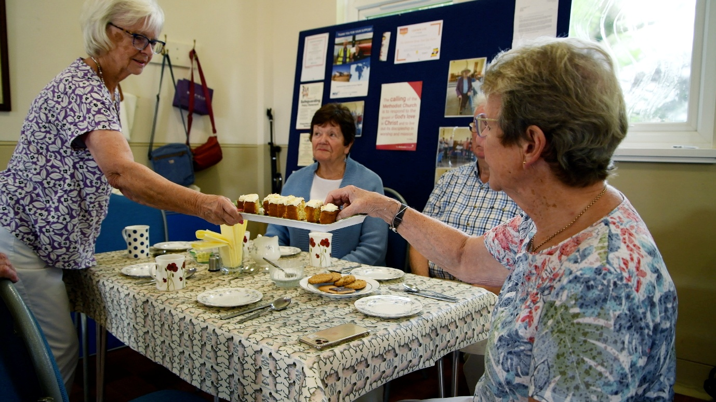
Case Studies
The Scots Gap Community Project, based at the Scots Gap Methodist Chapel is run by volunteers and began in the wake of Storm Arwen to support isolated and vulnerable people. The Chapel, the only community building in Scots Gap, is a designated Warm Space and ‘Friday at the Gap’ has become a regular weekly event, providing a warm welcome, friendship, and a hot meal for elderly residents. The hall also hosts a range of other vital community services including the Post Office, community choir, music group, art class, WI and Cambo tea club as well as celebratory events, with people from up to 20 miles away attending. Many of the activities, including Friday at the Gap are free and are open to the whole community, regardless of faith.
The additional activity at the Chapel highlighted the out-of-date kitchen facilities, originally designed for making teas and coffees after chapel, not satisfactory for the additional use that the warm spaces hub and other organisations required. Furthermore, the facilities no longer met health and safety regulations with the old boiler often breaking down, the grant helped to fund the purchase of a new boiler and refurbishment of the kitchen area.
"What a privilege to have this place to come to. An essential meeting place especially for us elderly. All reluctant to go home. A big Thank you to those volunteers who make this possible", Margaret.
"This has become a lifeline for so many local people. Every Friday such a wonderful friendly experience- we love it", Spencer and Maureen.
"So enjoy Friday at the Gap. Some weeks I never see anyone until Friday. People are so friendly - Best thing ever”, Ann.
"As you get older, we miss company- but we get so much friendship at Scots Gap", Dianna.
"Me and Mam come to meet people, enjoy a meal and we don't have to cook or wash up!" Joyce.
Scots Gap Methodist Chapel – Friday at the Gap
Community Benefit Fund
Scots Gap Community Group
£3,500

Slide 24
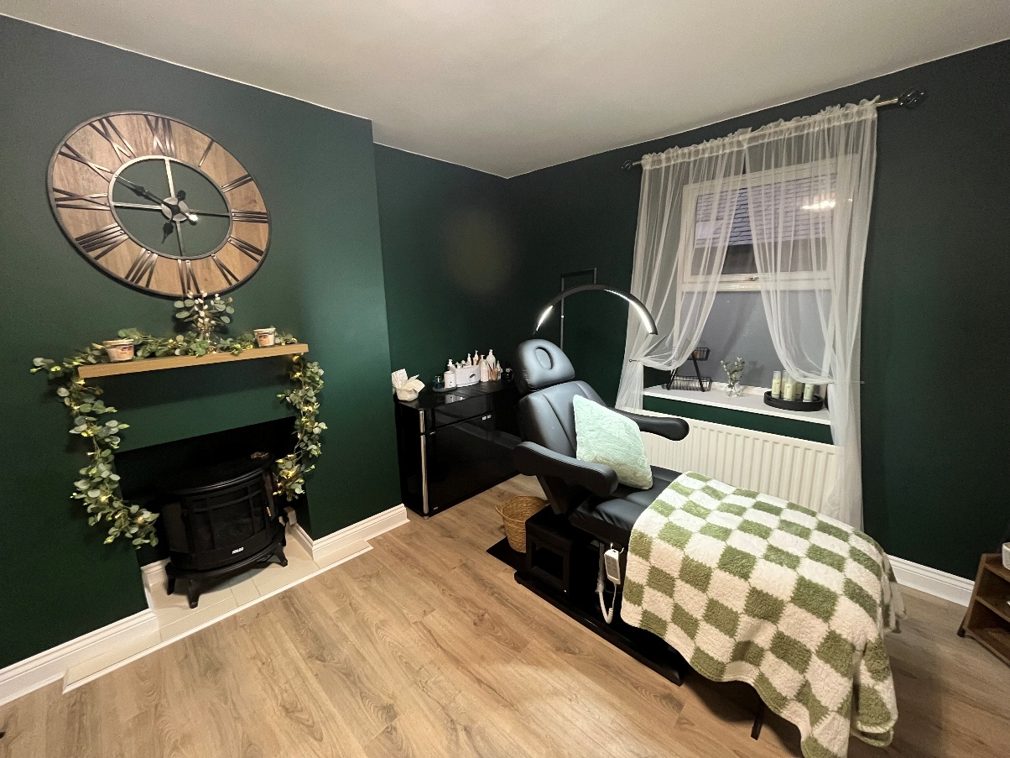
Case Studies
Melissa opened her Beauty Therapy Services in 2017, trading first as a mobile beauty therapist and then securing premises in 2019 in Bellingham. She offers female & male treatments including, manicure, gel manicure, pedicures, hair removal, eye treatments, male foot treatments, occasion hair & make up.
A larger salon space became available in Bellingham, offering the ability for Melissa and her employee to have separate treatments rooms or multiple nail stations and provided the prospect of expanding her business. The larger space would also provide a dedicated room for a hairdressing service, this would be new to the area and the new larger space would allow the current staff member to reach her full potential, with more treatments offered. There may be opportunity to offer new treatments and potentially hire more staff as the business grows.
Melissa also hopes to be able to recommence home visits for those unable to access the salon either due to age, mobility issues or for other reasons.
Melissa used the grant to purchase equipment to kit out her new salon.
“The Ray Wind Funds grant has made a world of difference to the salon. We are now able to offer so many more appointments and services, we have extra training lined up for both myself and my employee. The salon itself is done to a high standard to provide the best possible comfort in services for clients. The hair area and the extra space for treatments will give us the chance to provide much needed employment in the local area for the future as well as training opportunities for those who are looking to get into the industry. “Melissa Pick, Melissa’s Beauty Box.
One of the new treatment rooms at Melissa’s
Beauty Box, Bellingham
Community Benefit Fund
Melissa’s Beauty Box
£7,000

Slide 25
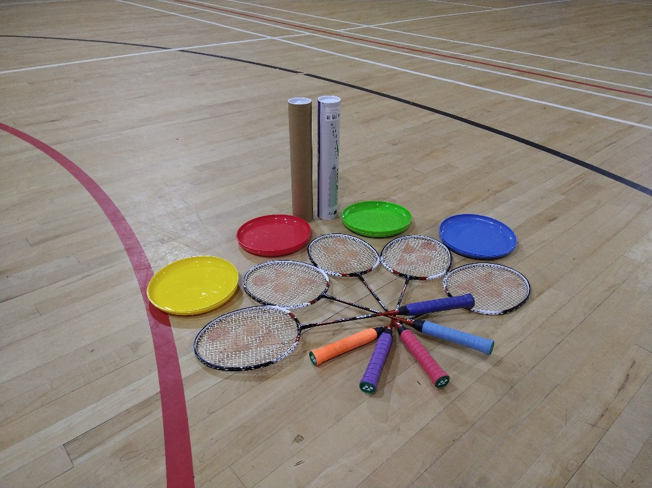
Case Studies
Otterburn Badminton Club started in 2023 on a Monday evening at the RTC Sports Centre in Otterburn, for adults of all abilities. The organiser wished to make the current club sustainable and to expand the Badminton community, they wanted to open a family session at the RTC Sports Centre.
The club required some new equipment – shuttlecocks, nets, badminton kits and grips to sustain the club and allow expansion to include all the family. Access to sporting opportunities is one of the priorities for the Ray Wind Funds and Directors were pleased to grant the funding and are happy to note that the Club now manages to host two weekly badminton clubs which are very well attended and quite competitive!
“When we started the badminton club, it was on a bit of a whim simply because I missed the playing the sport myself, there was no facts or information to support me setting up this club and that it would be a success. However, we have steadily built the club up over the past two years, from just a single adults badminton session to now having two hours of adult badminton and 1 hour of family badminton, all being well attended, with more things being planned and to come in 2026, such as some friendly games with some well established Northumberland teams and some competitions being hosted by ourselves at the RTC Sports Centre. The money we received from the Ray Wind Fund, hugely helped us to establish our own equipment separate from the sports centre to ensure the ability to continue to grow and to safeguard the RTC's equipment and our own equipment as well. It has allowed us to focus on bringing specific and adaptive equipment for the family badminton sessions to allow the club to be more inclusive to younger age groups, enabling us to reach and introduce badminton to children at a younger age, ensuring its fun and enjoyable for them.” Mark Nicholson, Otterburn Badminton Club.
Photo showing updated equipment
Otterburn Badminton Club
£334
Small Donations Fund

Slide 26
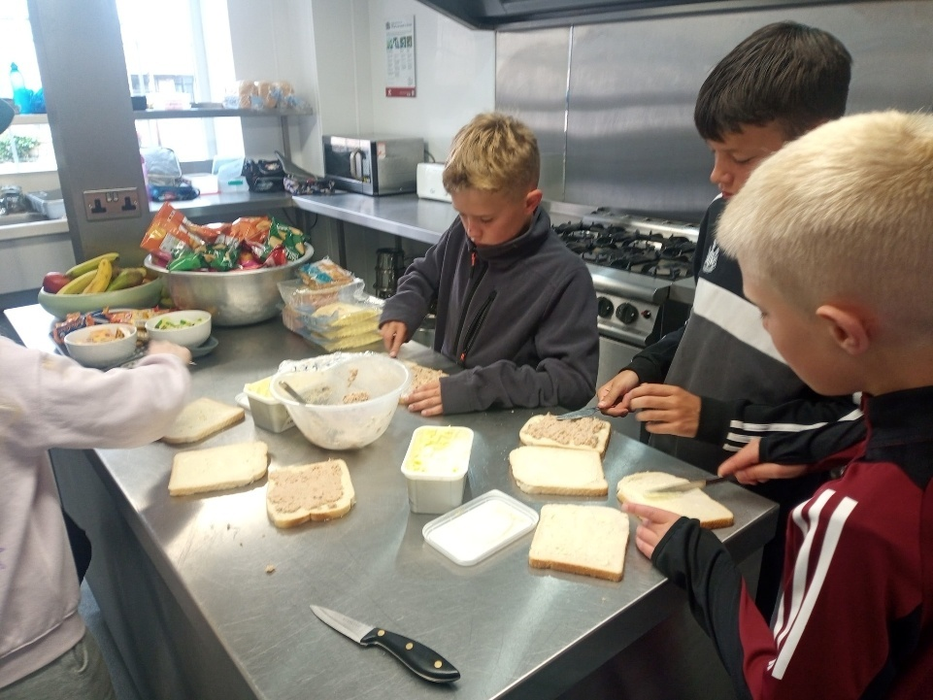
Case Studies
We continued to support schools across the area of benefit and have included the nursery and wraparound care facilities for the second full academic year. As with previous years the funding must not replace statutory provision and schools are given the freedom to use the termly donations where the need is greatest.
Cambo First School used the grants to pay for transport to swimming lessons, a trip to the pantomime and a music teacher. They also paid for a variety of different specialist workshops throughout the year. Cambo Wraparound - preschool and after school care, used their funding to provide meals and snacks for the children -free school meals are only provided by the government for Reception to Year 2 children. To cover the cost for some children at the holiday club and to purchase additional outdoor equipment. Cambo First School were awarded a standalone grant towards the cost of installing a cycle track in school grounds to promote physical and mental health and wellbeing among the pupils who had been instrumental at the planning stage and in the design of the track.
Wark Primary School & Nursery spent their donation on ‘Commando Jo’, a sports provision, as well as the cost of taking the children to school Partnership sporting events with other local schools. Nursery were able to provide free provision where needed, cover the cost of meals and contribute to the sporting provision.
Chollerton First School & Nursery used the Ray Wind Funds money to fund transport for swimming and to subsidise trips to see performances at the Northern Stage, visit the Hancock Museum, a trip to Newbiggin and other such activities. Their Early Years setting used the money for resources as well as a nursery visit to Hexham cinema and Queens Hall.
Belsay Primary School’s funding helped to fund transport to take the children swimming and for transport to inter school events to ensure the children had the same opportunities as children at larger schools in Ponteland. Belsay Daycare have been able to utilise the funding for an extensive range of trips to Druridge Bay,
Belsay Primary School, Bellingham Primary School, Cambo First School, Chollerton First School and Nursery, Otterburn Primary School and Nursery, Wark Primary School and Nursery, Bellingham Middle School, Belsay Daycare, Cambo Wraparound and North Tynies
Collectively £57,530
Community Benefit Fund, Education Apprenticeship and Training Bursary and Small Donations Fund

Slide 27
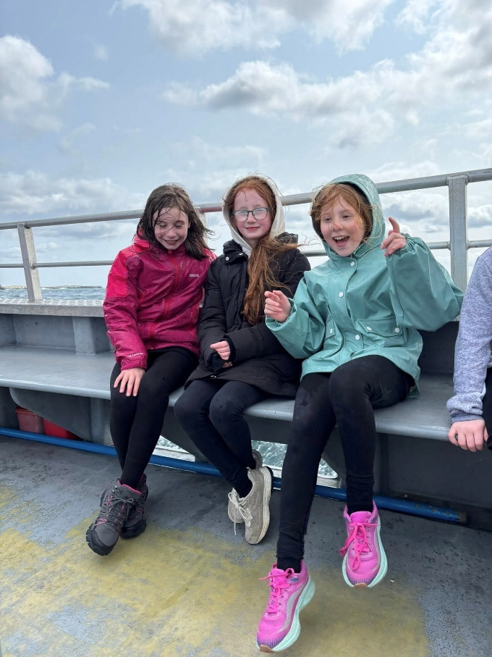
Case Studies
Whitehouse Farm, Centre for Life with a particular focus on learning where food comes from, the Hancock Museum and the Sea Life Centre, their recent OFSTED inspection referenced these experiences.
Outdoor resources were also purchased. “I would like to begin by sincerely thanking the Board at Ray Wind Funds, for the continued generous support you show to our school throughout the academic year. Your contribution is invaluable, particularly at a time when school finances are being severely stretched.” Craig Shaw, Headteacher at Belsay Primary School.
Otterburn Primary School & Nursery used the donation predominantly to fund the swimming lessons but also to support other trips and resources to assist the children’s learning experiences. The preschool used their funding to purchase outdoor equipment to enhance their outdoor space which had been referenced in an OFSTED inspection. Otterburn Primary School also secured a grant towards the cost of their residential trip to Bamburgh and Seahouses for years 5 and 6. "It’s wonderful to see how the grants open up opportunities for pupils, helping them to enjoy experiences they might not otherwise have access to." Alison Woodcock, Headteacher at Otterburn Primary School & Nursery.
Bellingham Primary School spent their funding on support for transport to swimming lessons, a Christmas pantomime trip and other sporting events. Bellingham Middle School used their donation to provide a trip to the Sill, the pantomime and Hancock Museum.
North Tynies put their funding towards supporting the meals for children in the nursery and the wraparound facility ensuring all children received healthy food, prepared on site while at nursery.
Year 5 and 6 pupils of Otterburn Primary School – preparing packed lunches on their Seahouses residential and on a Farne Islands boat trip.

